Slide 1
Deep Learning
Deep Learning for Text
Chapter 11.1-11.3
Vera Hollink
2025

Slide 2


Natural Language Processing (NLP)
Natural language = human language
Vocabulary changes
Grammar not well-defined
NLP
do something useful with natural language
≠ understanding

Slide 3




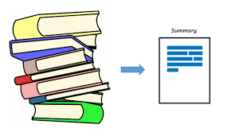
Some NLP Tasks
Economy
Sports
Entertainment
Text classification
Content filtering
Sentiment analysis
Translation
Summarization

Slide 4
Text preprocessing

Slide 5
Text preprocessing
The quick brown fox jumps over the lazy dog.
Normalization/standardization
the quick brown fox jumps over the lazy dog
Tokenization
“the” “quick” “brown” “fox” “jumps” “over” “the” “lazy” “dog”
Indexing
17 321 490 21 339 3021 17 591 111
Encoding
[[0,0,0,0,1,0], [[0,1,0,0,0,0], [[1,0,0,0,0,0], …]

Slide 6
Normalization/standardization
Lowercase
The ➔ the
Remove punctuation
. ? “ …
Convert special characters
résumé ➔ resume
Stemming
foxes => fox
approximation ➔ approximat
Disadvantage: information is lost
Advantage: less training data needed

Slide 7
Tokenization
the quick brown fox jumps over the lazy dog
Words
“the” “quick” “brown” “fox” “jumps” “over” “the” “lazy” “dog”
N-grams: sequences of N words
2-grams:
“the quick” “quick brown” “brown fox” “fox jumps” “jumps over” “over the” “the lazy” “lazy dog”
3-grams:
“the quick brown” “quick brown fox” “brown fox jumps” “fox jumps over” “jumps over the” “over the lazy” “the lazy dog”
Characters
“t” “h” “e” “q” “u” “i” “c” “k” “b” …

Slide 8
Indexing
Assign number to each token
the ➔ 17
quick ➔ 321
Use only N most frequent tokens (e.g. 10000)
other tokens get index 1
Create vectors
[17 321 490 21 339 3021 17 591 111]
If fixed length needed, pad with 0’s:
Length 12:
[17 321 490 21 339 3021 17 591 111 0 0 0]

Slide 9
Text preprocessing in Keras
Preprocessing module
from tensorflow.keras.layers import TextVectorization
dataset = ['The brown dog jumps.','Dog jumps over the fox.']
text_vectorization = TextVectorization(output_mode='int')
text_vectorization.adapt(dataset)
text = 'The quick brown dog jumps.'
encoded_text = text_vectorization(text)
print(encoded_text)
Default: lowercase, remove punctuaction, split on whitespace
There are many alternative options
Create vocabulary: give each token a number
1 for unknown word
Apply to new data
tf.Tensor([2 1 7 4 3], shape=(5,), dtype=int64)

Slide 10
Text preprocessing
The quick brown fox jumps over the lazy dog.
Normalization/standardization
the quick brown fox jumps over the lazy dog
Tokenization
“the” “quick” “brown” “fox” “jumps” “over” “the” “lazy” “dog”
Indexing
17 321 490 21 339 3021 17 591 111
Encoding
[[0,0,0,0,1,0], [[0,1,0,0,0,0], [[1,0,0,0,0,0], …]

Slide 11
Bag-of-word representations
Multi-hot encoding
text_vectorization = TextVectorization(max_tokens = 10000, output_mode='multi-hot')
Doc id | dog | fox | jump | over | …
1 | 1 | 0 | 1 | 0 | …
2 | 1 | 1 | 0 | 0 | …
3 | 1 | 0 | 0 | 0 | …
4 | 0 | 1 | 0 | 0 | …
5 | 0 | 1 | 1 | 1 | …
… | … | … | … | … | ...

Slide 12
Bag-of-word representations
2. Frequency encoding
text_vectorization = TextVectorization(max_tokens = 10000, output_mode='count')
Doc id | dog | fox | jump | over | …
1 | 2 | 0 | 1 | 0 | …
2 | 1 | 2 | 0 | 0 | …
3 | 4 | 0 | 0 | 0 | …
4 | 0 | 1 | 0 | 0 | …
5 | 0 | 6 | 2 | 1 | …
… | … | … | … | … | ...

Slide 13
Bag-of-word representations
3. Tf.idf encoding
Value = importance score of the token
text_vectorization = TextVectorization(max_tokens = 10000, output_mode='tf_idf')
Doc id | dog | fox | jump | over | …
1 | 2.6 | 0 | 0.2 | 0 | …
2 | 0.9 | 2 | 0 | 0 | …
3 | 3.2 | 0 | 0 | 0 | …
4 | 0 | 0.9 | 0 | 0 | …
5 | 0 | 2.1 | 1.9 | 0.1 | …
… | … | … | … | … | ...

Slide 14
Bag-of-word representations
N-gram encoding (multi-hot)
text_vectorization = TextVectorization(n_grams=2, max_tokens = 10000, output_mode='multi-hot')
Doc id | dog_jump | jump_over | over_the | …
1 | 1 | 0 | 0 | …
2 | 0 | 0 | 0 | …
3 | 0 | 0 | 0 | …
4 | 0 | 0 | 0 | …
5 | 0 | 1 | 1 | …
… | … | … | … | ...
count or tf_idf also possible

Slide 15
Exercise: text preprocessing and encoding
Two documents “Are oranges always orange?” “The cat ate the oranges.”
Apply stemming and other normalization techniques
Apply tokenization
Encode using
Bag-of-words with multi-hot encoding
Bag-of-words with frequency encoding
Bag-of-words with 2-gram multi-hot encoding

Slide 16
Exercise: text preprocessing and encoding
Two documents document 1: “Are oranges always orange?” document 2: “The cat ate the oranges.”
Apply stemming and other normalization techniques
Apply tokenization
[are, orange, always, orange]
[the, cat, ate, the, orange]

Slide 17
Exercise: text preprocessing and encoding
Bag-of-words with multi-hot encoding
Doc id | are | orange | always | the | cat | ate
1 | 1 | 1 | 1 | 0 | 0 | 0
2 | 0 | 1 | 0 | 1 | 1 | 1
Bag-of-words with frequency encoding
Doc id | are | orange | always | the | cat | ate
1 | 1 | 2 | 1 | 0 | 0 | 0
2 | 0 | 1 | 0 | 2 | 1 | 1

Slide 18
Exercise: text preprocessing and encoding
Bag-of-words with 2-gram multi-hot encoding
[are_orange, orange_always, always_orange]
[the_cat, cat_ate, ate_the, the_orange]
Doc id | are_orange | orange_always | always_orange | the_cat | cat_ate | ate_the | the_orange
1 | 1 | 1 | 1 | 0 | 0 | 0 | 0
2 | 0 | 0 | 0 | 1 | 1 | 1 | 1

Slide 19
Deep Learning models for text
Dense models
Recurrent Neural Networks
Transformers (next week)

Slide 20
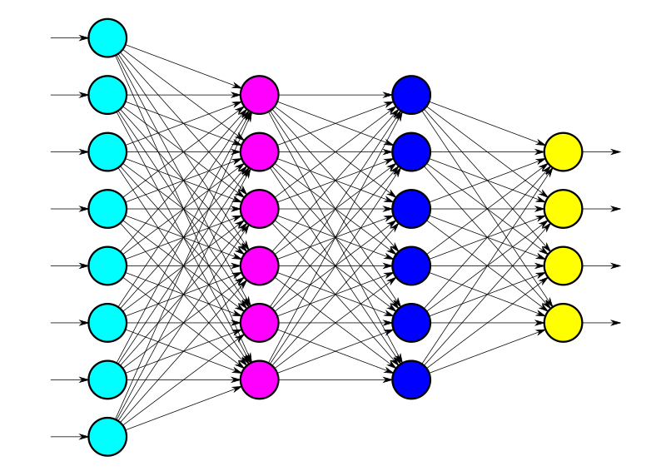
Deep Learning models for text
Dense models
Recurrent Neural Networks
Transformers (next week)

Slide 21
Dense model
Input: document encoded as bag-of-words
Multi-hot: [0,0,1,0,0,0,0,0,0,1,0,0,0,0,0,1,0…]
Frequency: [0,0,2,0,0,0,0,0,0,1,0,0,0,0,0,3,0…]
tf_idf: [0,0,2.4,0,0,0,0,0,0,0.9,0,0,0,0,0,1.3,0…]
Dense model:
model = Sequential()
model.add(Dense(50, input_shape=(n_words,), activation='relu'))
model.add(Dense(1, activation='sigmoid’))
Disadvantage: word order is lost
Partly solved with N-grams, but very short sequences
Number of words in the vocabulary

Slide 22
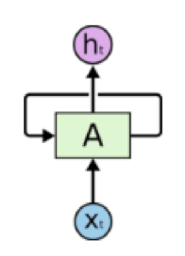
Deep Learning models for text
Dense models
Recurrent Neural Networks
Transformers (next week)

Slide 23
RNN
Sequence processing: (bidirectional) LSTM
inputs = keras.Input(shape=(None,), dtype="int64")
embedded = tf.one_hot(inputs, depth=max_tokens)
x = layers.Bidirectional(layers.LSTM(32))(embedded)
x = layers.Dropout(0.5)(x)
outputs = layers.Dense(1, activation="sigmoid")(x)
model = keras.Model(inputs, outputs)
One-hot encoding:
Each word is a vector with exactly one 1 [0, 0, 0, 0, 0, 0, 1, 0, 0, 0, 0, …]
A sample (document) is a 2-dimensional vector [[0, 0, 0, 0, 0, 0, 1, 0, 0, , …], [0, 0, 0, 0, 0, 0, 0, 0, 0, 1, …], [0, 0, 1, 0, 0, 0, 0, 0, 0, …], …]
A batch has a number of sequences with the same length
Use cut-off and padding with 0’s
One batch is for instance 256x20000x600 ➔ training is slow
samples x max_tokens x sentence_length

Slide 24
RNNs and Convnets for text
(bidirectional) LSTM
(bidirectional) GRU
1D Convolutional Network
Disadvantage:
Slow because input is huge samples x max_tokens x sentence_length

Slide 25
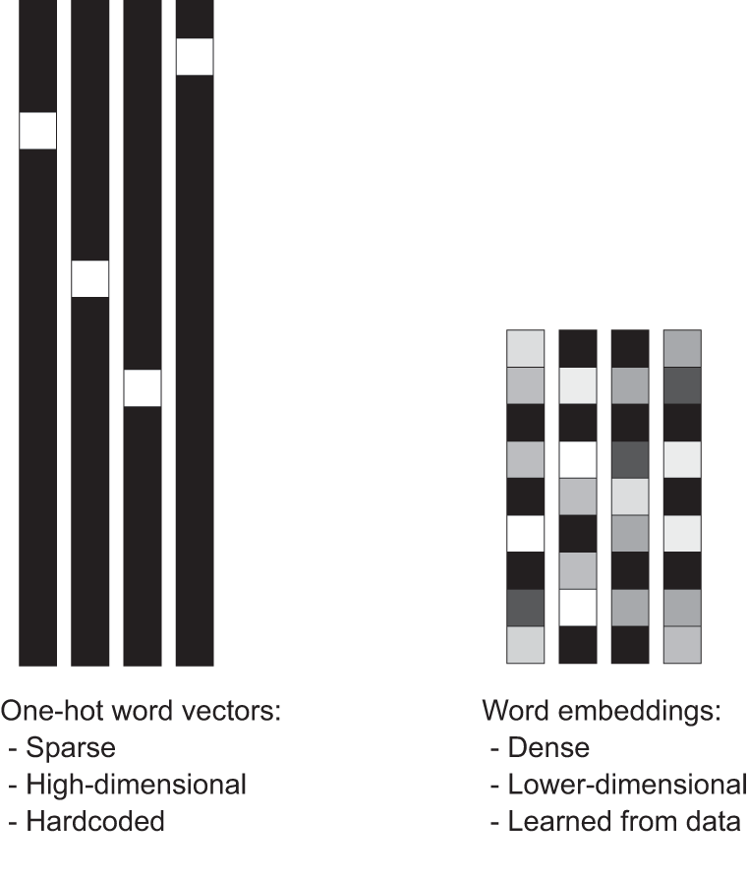
One-hot embedding vs word embeddings
One-hot embedding:
Dog [0, 0, 0, 0, 0, 0, 1, 0, 0, 0, 0, …]
Cat [0, 0, 0, 0, 0, 0, 0, 0, 0, 1, 0, …]
Word embeddings:
Dog
[0.12, 0.30, 0.20, 0.24]
Cat
[0.73, 0.13, 0.40, 0.44]

Slide 26
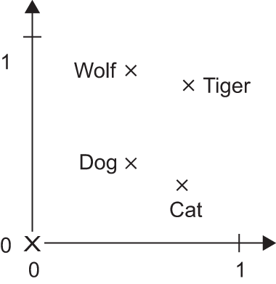
Advantages word embeddings
Smaller representation
E.g. 20000 x 600 becomes 256 x 600
Vector distances can represent meaning
Similar words can have similar vectors e.g. vector cactus closer to vector aloe than to vector cat
Meaningful dimensions
Gender, singular/plural, …
Emerging, not hard-coded

Slide 27
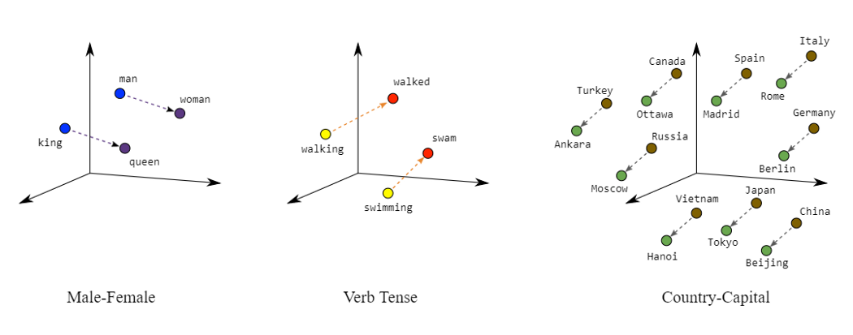
Advantages word embeddings

Slide 28
Learning word embeddings
Transform word indexes to word vector
[17 321 490 21 339 3021 17 591 111 0 0 0] ➔
[[0.72, 0.34, 0.1, ..], [0.32, 0.70, …], …]
Initialize randomly, learn to structure space through backpropagation (more similar words get closer vectors)
inputs = keras.Input(shape=(None,), dtype="int64")
embedded = layers.Embedding(input_dim=max_tokens, output_dim=256, input_length=600, mask_zero=True)(inputs)
x = layers.Bidirectional(layers.LSTM(32))(embedded)
x = layers.Dropout(0.5)(x)
outputs = layers.Dense(1, activation="sigmoid")(x)
model = keras.Model(inputs, outputs)
Length of word vector
Number of words in sequences
Size of the vocabiary
Make sure padding (trailing 0’s) is not used in training.

Slide 29
Using pretrained word embeddings
Meaning/embedding not specific for data set or task
Use existing embedding
Get embedding matrix: pretrained vector for each word
Initialize embedding with matrix
Fix embedding (layer not trainable)
embedding_layer = layers.Embedding(max_tokens, embedding_dim, embeddings_initializer=keras.initializers.Constant(embedding_matrix), trainable=False, mask_zero=True
)

Slide 30


Popular pretrained word embeddings
word2vec:
made by Google
based on news data
vector length 300
GloVe:
made by Stanford,
based on various sources (various versions available), such as Wikipedia and WWW crawl and Twitter,
vector length 25-300

Slide 31
Using pretrained word embeddings
Advantages?
Less training and data needed
Based on large corpus
Disadvantages?
Not specialized for your task (e.g. sentiment analysis)
Not specialized for your texts (e.g. reviews)

Slide 32
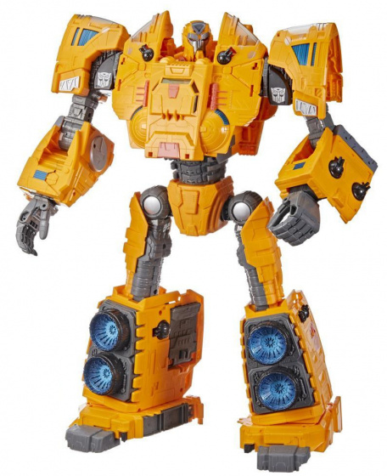
Deep Learning models for text
Dense models
Recurrent Neural Networks
Transformers (next week)

Slide 33

Test your understanding!

